Slide 1
Climate Service Management
Team 1
Service Oriented Computing (18-655), Fall 2015

Slide 2

Motivation
Enhance The Usability Of Climate Service
Give A Concise But Elegant Climate Service Page
Build The Bridges among The Researchers
Enable Interaction Among Researchers
Provide The Feedback From Other Users
Improve The Work Efficiency Of Researchers
Help You Find the Services You Like
We Know What Service You May Need !
We Know What Service Is Popular

Slide 3
Introduction
During the past 5 weeks, members of Team1 implemented a climate service management service. Technologies we have used include but not limit to Hibernate, AJAX, Docker and mySQL.
We implement basic functions like “services keyword search”(find first three services by keywords) and “service grade”(give grade to a service), to improve user experience, all the previous service versions can be shown in the Climate Service page, top3 climate services can be got according to their grades and used frequency.
In addition, sign “@” can be used to mention a friend and “#” can be used to mention a specific climate service. Hibernate is used as the backend framework to manage mySQL database
We also added two useful functions - tag and recommendation function for your convenience. Tags are added with comment to describe a climate service. People can also choose to ‘like’ a climate service and system will recommend suitable climate service for user according to history records and user’s favor.

Slide 4
Technical Overview
Docker Container
Simplify development environment configuration
Play Framework
High velocity web framework for Java and Scala
Hibernate
Object/Relational Mapping (ORM) framework
Ajax
Avoid reloading the whole web page

Slide 5
Our Implementation
Sprint 1
Login & Register
Sprint 2
Keyword Search
Grade a Service
Version Control
Sprint 3
Mention a Service using ‘#’
Mention a User using ‘@’
Extra Implementation
Tag a Service
‘Like’ And Recommend

Slide 6



System Design
Request
Request
Response
Response
FrontEnd
BackEnd

Slide 7
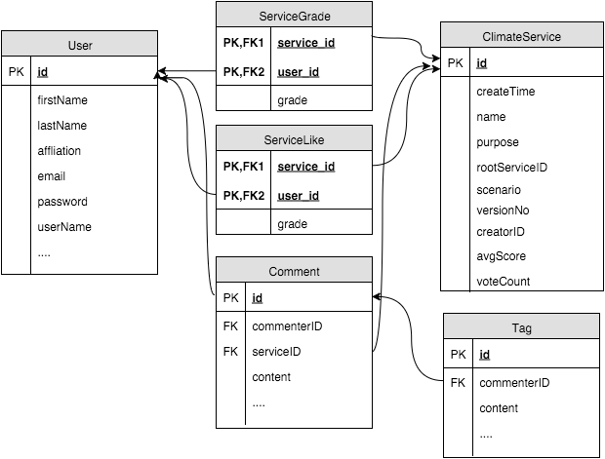
Database Schema
BCNF
Lossless
Dependency Preserve

Slide 8
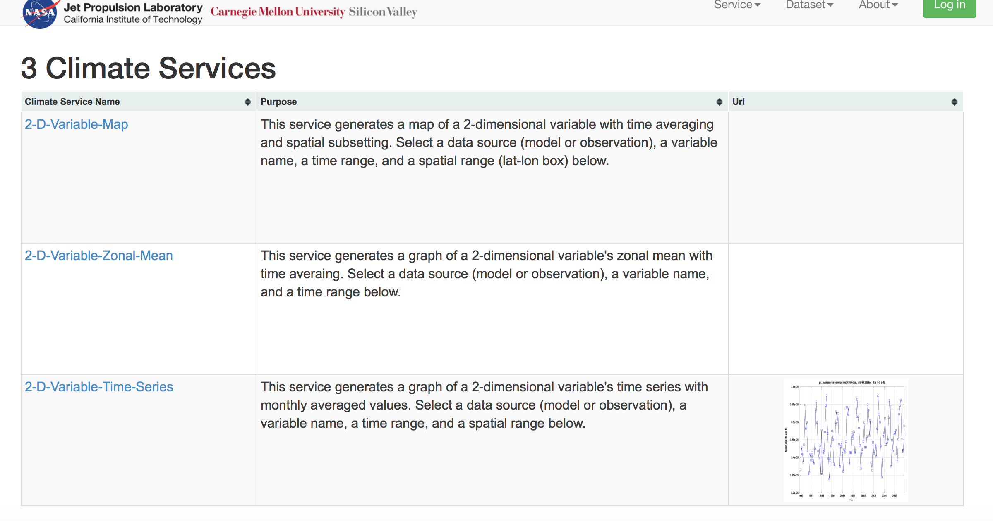
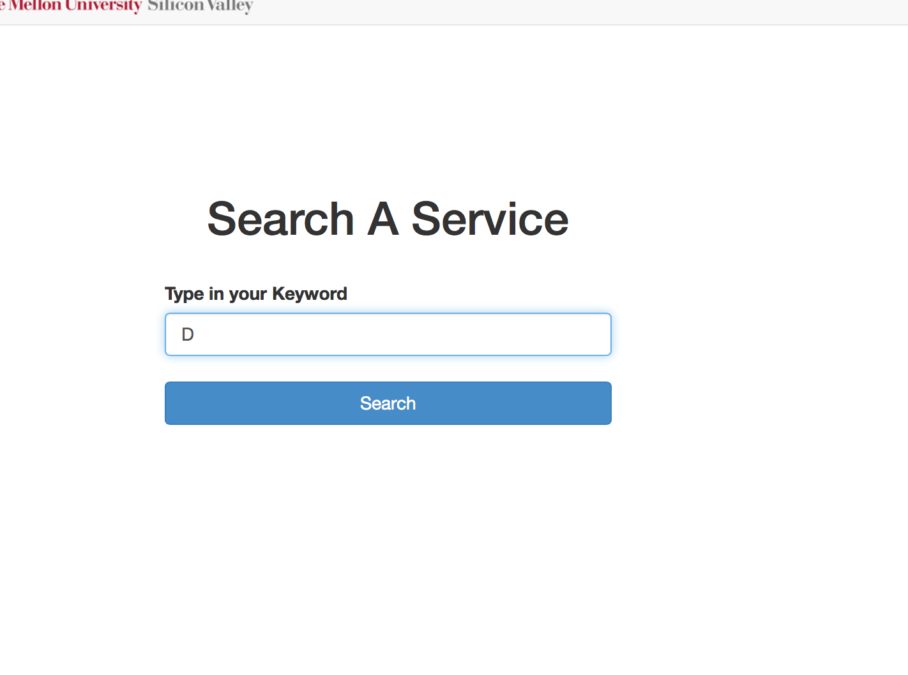
Demo - Key Word Search
Search Page
The Results

Slide 9
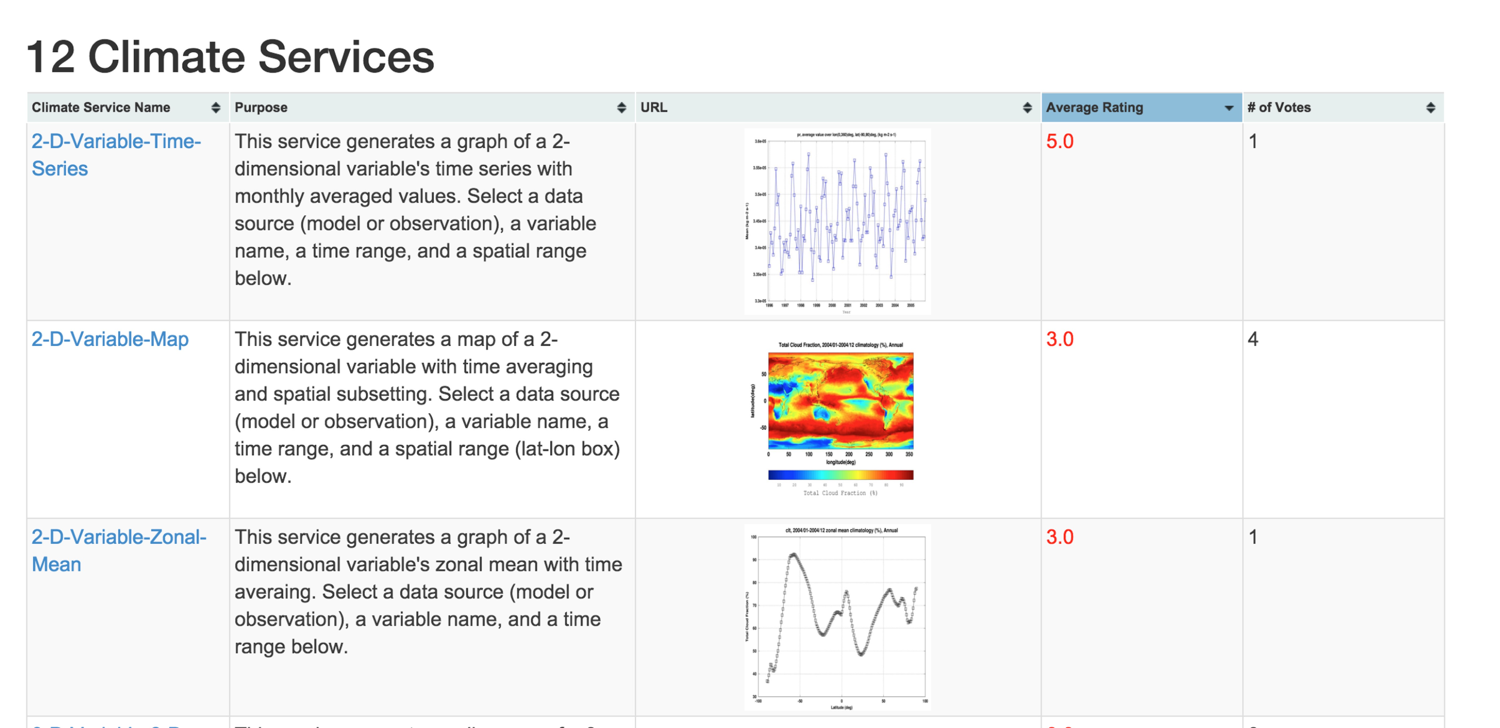
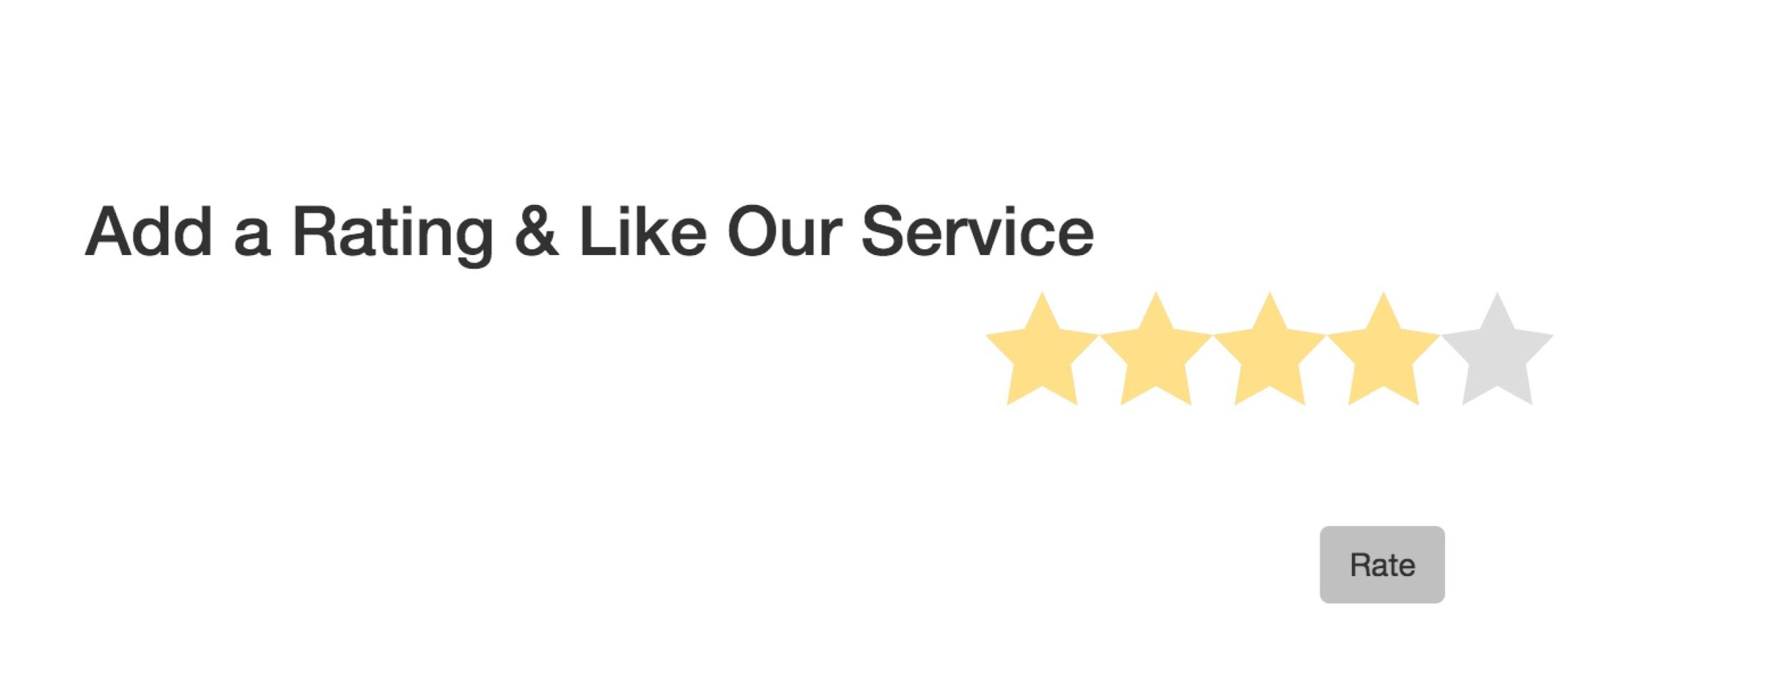
Demo - Grade a Service
User can grade a Service
Calculate average score for each service
Order services by average score

Slide 10
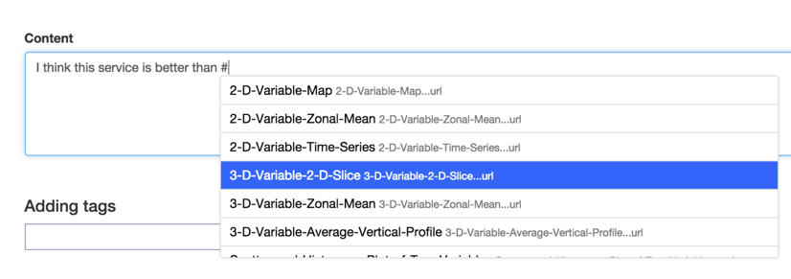
Demo - Mention a Service Using ‘#’
In the html, we use the Ajax to retrieve the service list from backend to mention a service.
It reduce the load for client browser so that we do not need to load the whole page.

Slide 11
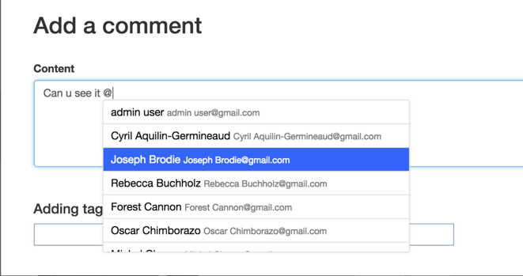
Demo - Mention a Friend Using ‘@’
In the html, we use the Ajax to retrieve the user names from backend to mention a service.
It reduce the load for client browser so that we do not need to load the whole page.

Slide 12
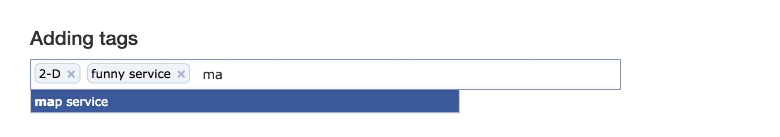
Demo - Tag a Service
Tag comes with comment to mark a specific service. When a user write and post a comment, he can add comment from available tags or design his own tag. Tags will be shown with comments.

Slide 13
Demo - Like And Recommend
User can like a service in the climate service page.
Recommend Services based on ‘Like’
Example
Alice likes services S1, S2, S4.
Bob likes Service S1, S2.
It is highly possible that Bob would also like S4.
Recommend Bob S4!

Slide 14
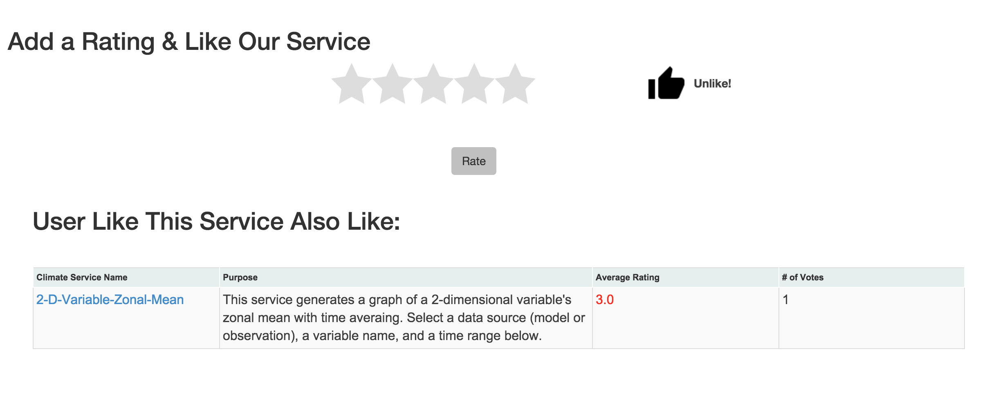
Demo - Like And Recommend

Slide 15
Conclusions
From this project, we valid our knowledge of service-oriented computing and learn a lot from both Frontend and Back-end structure of a climate web service. We implemented and tested our project in Docker environment.
At Front-end, we handle necessary Front-end design language like HTML and Javascript. We used AJAX technology in the Implementation of “@” and “#” to refer to specific person or service. At Back-end, we get familiar with Hibernate framework and understand how to map database tables to java classes. mySQL database is selected to be our Back-end and we use Hibernate API and SQL to operate on database.
We also gain experience of operation between Frontend and Back-end and learn a lot about Play Framework.

Slide 16
Future Work
In the future, this web service still need to be improved. Better user-friendly interface and interaction with social network will be a good direction.
Provide A Service Management Ecosystem.
Introduce The Concept Of Friend Circle And Researchers Group
Show The Timeline of Climate Service Development
Improve The UI Further
Add More Dynamic Content And Interactive Elements
Implement A More Sophisticated Evaluation Mechanism
Include More Metrics
GIve More Powerful Recommendation

